Slide 1
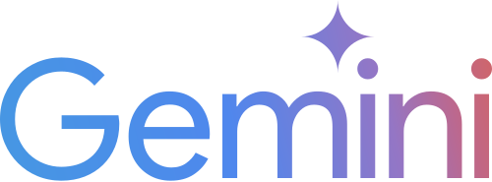

Google Step up Career Challenge
Mission: Power Google’s Gemini Pro Breakthrough
Budget: $ 10M USD
Target: University Student
Length: 8 Weeks
Markets: 3
Matthew Lau

Slide 2
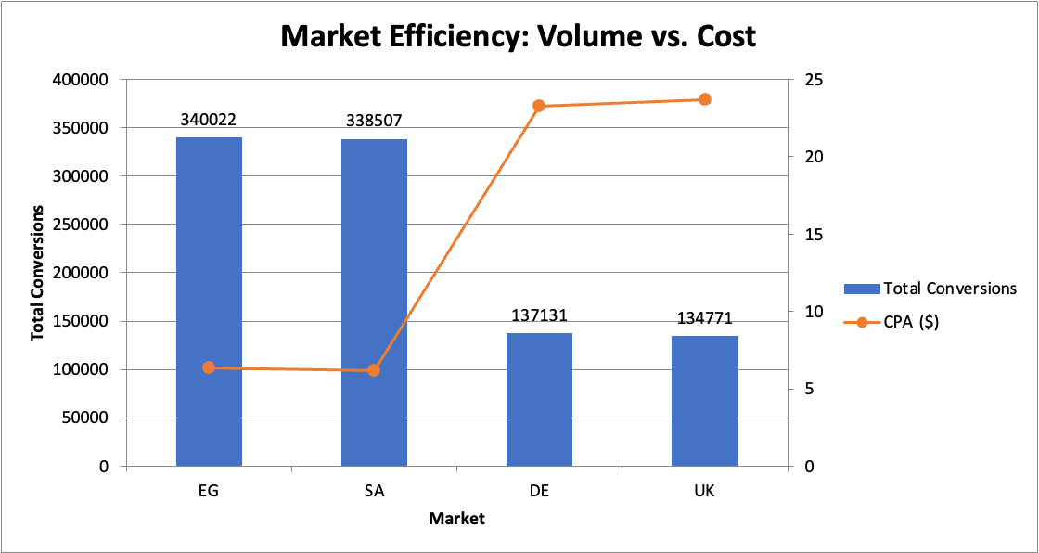
Insight 1 : High Efficiency in Emerging Markets (Egypt (EG) and Saudi Arabia (SA)
Data Science Route
EG and SA are the most efficient markets for driving conversions, significantly outperforming the United Kingdom (UK) and Germany (DE) in cost-effectiveness.
EG and SA achieved the highest conversion volumes (~340k and ~338k respectively).
Both markets maintain a much lower Cost Per Acquisition (CPA) of approximately $6.33, compared to over $23 in the UK and DE.
While total reach is lower in EG/SA, the Cost Per Reach (CPR) is consistent across all markets (~$0.036), indicating that the audience in these regions is naturally more responsive to the current channel mix.
For more information: https://github.com/Matthew1819Lau/Google-Step-Up-Challenge.git

Slide 3
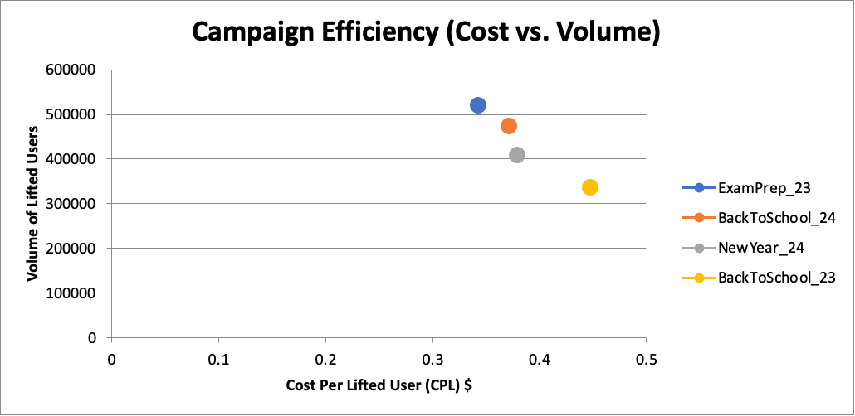
Insight 2 : Strategic Timing: Maximizing Impact during Exam Periods
Academic-focused campaigns, particularly "Exam Preparation", it shows the highest efficiency in lifting brand metrics, suggesting that students view Gemini as a critical tool during high-stress study periods.
The ExamPrep_23 campaign delivered the second-highest absolute lift among all seasonal efforts in Brand Lift Study Dataset.
It also achieved the lowest Cost Per Lifted User (CPL), making it the most economical period to acquire new high-intent users.
Increasing marketing spend during these windows (Back to School and Exam Prep) will likely yield the highest Return of Investment (ROI).
For more information: https://github.com/Matthew1819Lau/Google-Step-Up-Challenge.git

Slide 4
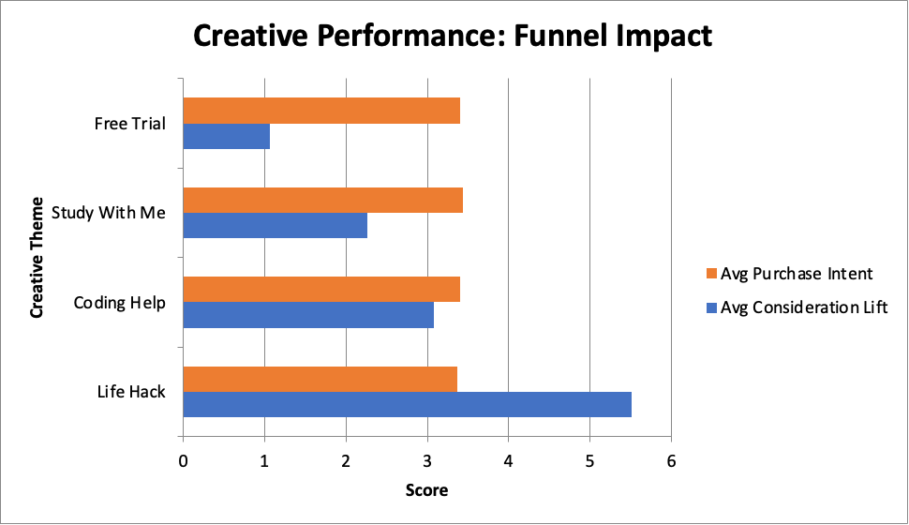
Insight 3 : Creative Strategy: Awareness Vs Conversion
Creative content should be segmented by funnel stage. "Life Hack" content is superior for building initial awareness, while utility-based content drives actual purchase intent.
The "Life Hack" creative consistently drives the highest average Consideration Lift, making it the best choice for top-of-funnel engagement.
Conversely, "Study With Me," "Free Trial," and "Coding Help" show the strongest impact on Purchase Intent.
Use "Life Hack" to attract attention and retarget those users with "Free Trial" or "Coding Help" to increase Gemini Pro conversion.
For more information: https://github.com/Matthew1819Lau/Google-Step-Up-Challenge.git

Slide 5
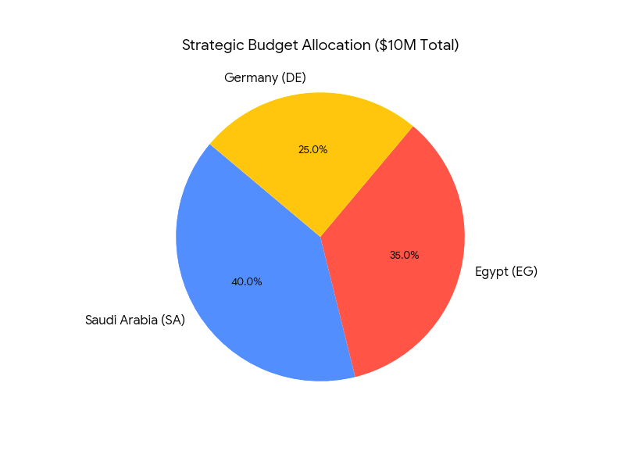
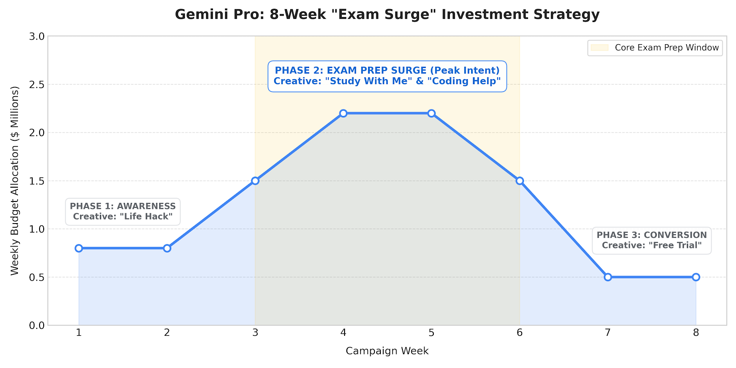
Data Strategist Route
8-Week Global Launch Strategy: High Impact and Seasonal Surge

Slide 6
Market Selection:
Saudi Arabia (SA): The "Efficiency Leader." Boasts the highest conversion rate (0.61%) and the lowest CPA ($6.16).
Egypt (EG): The "Growth Engine." High audience volume (59M reach) with near-identical efficiency to SA ($6.33 CPA).
Germany (DE): The "Scale Market." While more expensive ($23.25 CPA), it provides a massive audience of over 86M, ensuring the campaign achieves significant global "noise" and reach.
Media Execution: The Funnel Sequenced approach
Display (Top Funnel): Use this for massive reach at the lowest cost (~$0.019 per reach). This is purely to keep Gemini Pro "top of mind" during the 8-week period.
YouTube & Social (Middle Funnel): They provide a balanced Cost Per Reach (~$0.035) and are the natural environment for university students.
Search (Lower Funnel): The primary conversion driver. In SA/EG, Search delivers a CPA of $3.22, making it essential for capturing students actively looking for "study help" or "coding assistants."
Budget allocation ($10M Total):
Market Split: $4M Saudi Arabia > $3.5M Egypt > $2.5M Germany
Channel Split: 50% Performance (Search/Social) > 30% Video (YouTube), 20% Awareness (Display).
Creative Feature Focus: The Funnel Sequenced approach
Week 1-3 (Awareness): Lead with "Life Hack" content. This creative has the highest Consideration Lift (5.51). Its goal is to "excite" students by showing how Gemini simplifies their lives.
Week 4-6 (Consideration): Transition to "Study With Me" and "Coding Help." These themes showed the strongest Purchase Intent (3.4+). They demonstrate the utility required to turn a "fan" into a "user."
Week 7-8 (Action): Close with the "Free Trial" creative and a "Limited Time" offer for Gemini Pro to drive immediate sign-ups before the 8-week window closes.
For more information: https://github.com/Matthew1819Lau/Google-Step-Up-Challenge.git

Slide 7


Thank you

